Slide 1

Group G: Shengchen Fu, Tianyi Zhou, Lin Wang, Niqian Wu

Slide 2
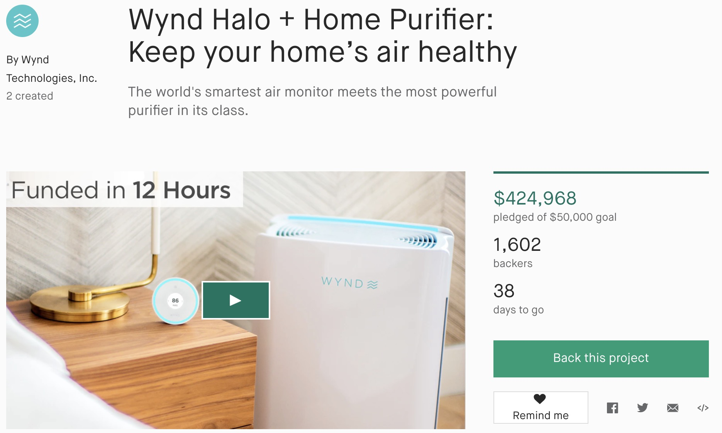
What is Kickstarter?
Online crowdfunding platform for start-up projects
“All-or-nothing” funding
Kickstarter fees:
Successful funding projects:
5% of total funds
How can Kickstarter increase its revenue?
What variables lead to successful projects?
What variables lead to higher pledge amount of projects?

Slide 3
Data Structure
Variable | Example
State | Failed, Successful, Live, Canceled
Main_category | Technology, Design
Goal | $1000, $30000
Pledged | $2421.00, $220.00
Backers | 3,15
Launched | 2015-08-11
Deadline | 2018-02-13
Data selecting:
Successful & Failed projects
Analysis
Live Projects
Prediction

Slide 4
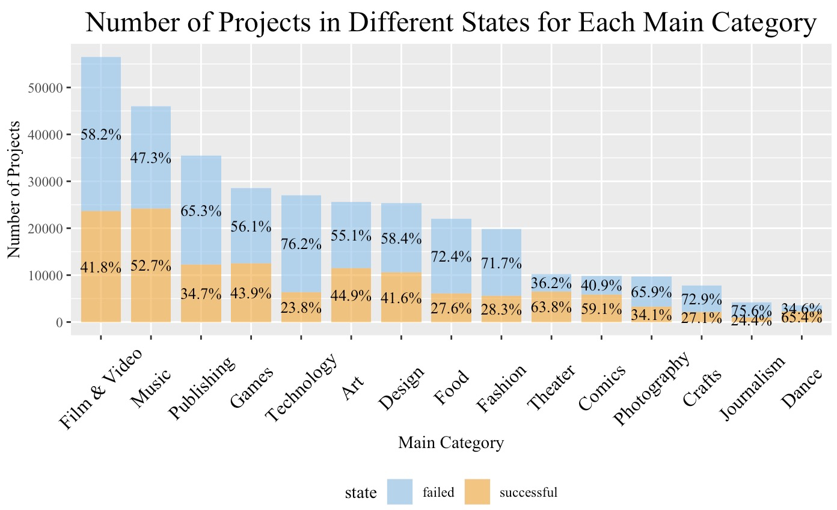
Which category is more successful?
Largest projects source: Film & Videos
Strong development prospects industries: Dance, Comics, Theater
Chi-test result:
Different categories have different proportions of failed and successful projects

Slide 5
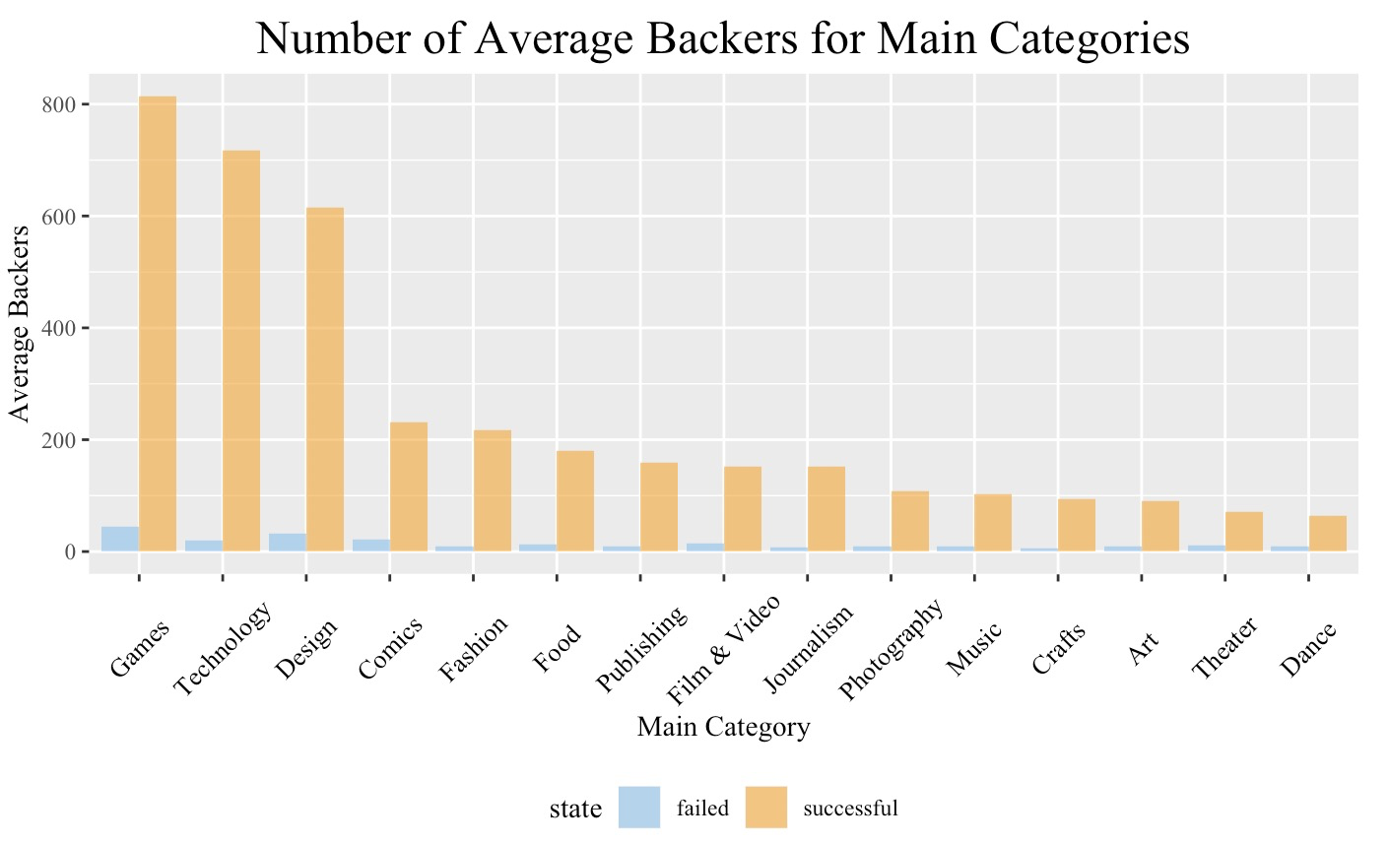
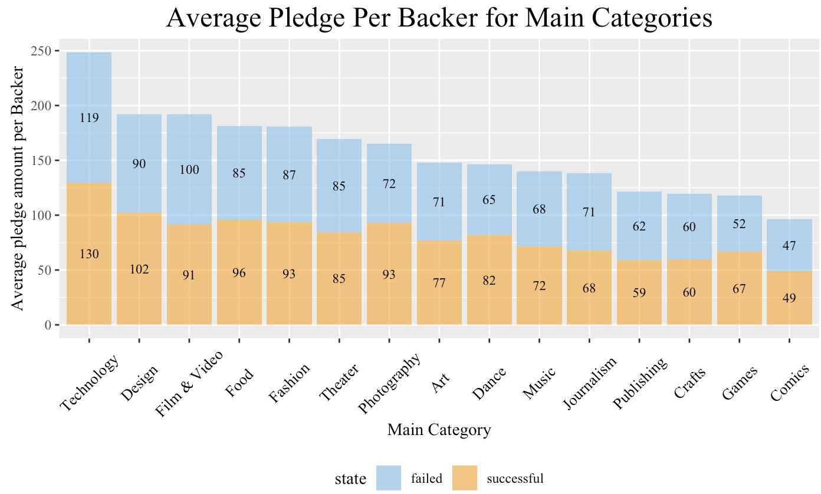
How did backers treat different categories?
More backers: Games, Technology and Design
Backers are generous to invest: Technology

Slide 6
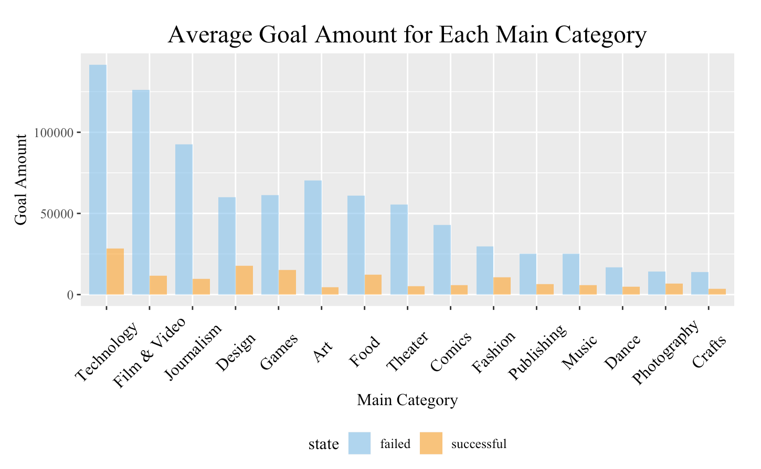
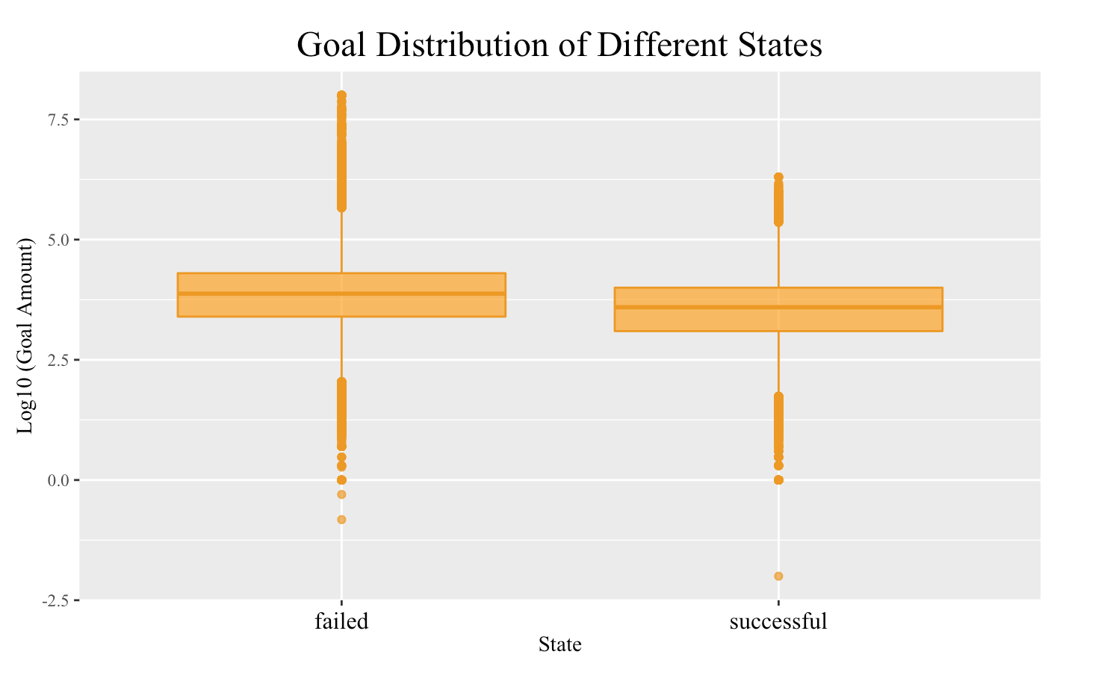
How did goal affect projects?
The goal amounts of successful projects were much smaller
Successful projects: smaller range with a lower position
Projects with reasonable goals are easier to success

Slide 7
Statistic Test: Where exist the difference ？
Successful proportion
Goal Reaching Ratio
Backers
Successful characteristics
Different categories had different proportion of failed and successful projects
High goal-reaching ratio: Music, Games, Comics, Technology, Art
On average, the backer numbers of successful projects were 17 times larger than failed projects
Successful projects: lower goals, higher pledged amounts, much higher goal-reaching ability
.

Slide 8
Logistic Regression: Who is likely to succeed?
Model:
Dependent variable: isSuccessful (0 or 1)
Independent variables: goal, backers, main_category
Higher successful probability
Theater
Dance
Film & Video
Music
Lowest successful probability
Games
Crafts
Journalism

Slide 9
Linear Regression: How to get more pledge?
Model 1:
Dependent variable: pledged
Independent variables: goal, backers, factor(main_category), factor(main_category) x backers
For all categories to get pledge:
backers
With 1 backer increase, who get more?
Design, Food, Photography
With same backers and goal, who raised more?
Technology
Model 2:
Dependent variable: pledged
Independent variables: goal, backers, factor(EndMonth), factor(EndMonth) x backers
Data: Technology projects
When is the better time to do promotion?
April, September, November
For Technology

Slide 10
Segmentation : Success has different ways
Group | Backers | Goal | isSuccessful
1 | 59735 | 524843 | 1
2 | 244.8 | 9367 | 1
3 | 16.43 | 43107 | 0
4 | 4.833 | 82704866 | 0
Guide projects to set a reasonable funding goal
Promote projects to attract more backers

Slide 11
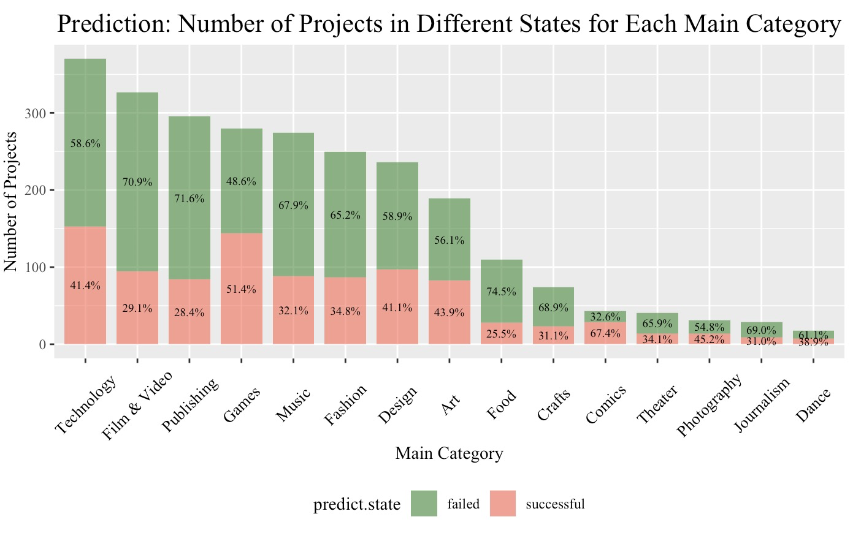
Prediction Analysis
Test data: Projects with “Live” state
Model:
Dependent variable: pledged
Independent variable: backers, goal, backers, factor(main_category), factor(main_category) x backers
Comics & Photography:
Few number of projects, high successful rate of category
Top 5 successful rate:
Comics
Games
Photography
Art
Technology

Slide 12
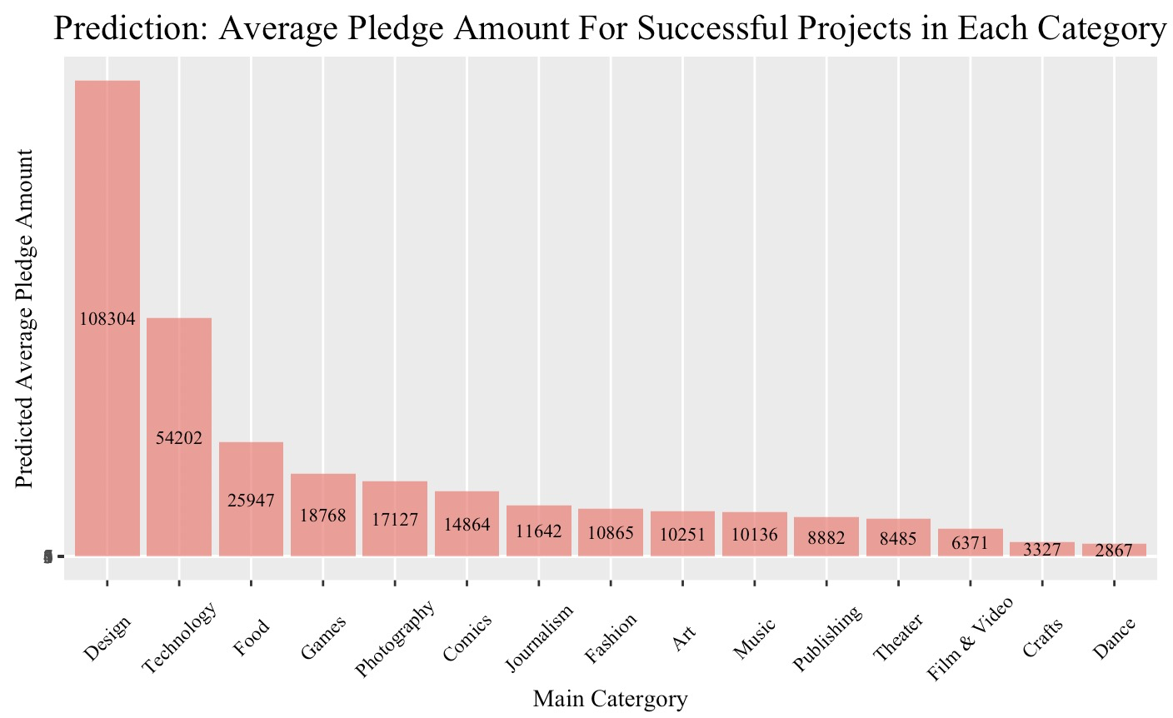
Prediction Analysis cont’d
Top 5 categories ranked by Predicted Revenue
main_category | Revenue
Design | 525275.05
Technology | 414649.25
Games | 135131.65
Fashion | 47263.95
Music | 44598.55
Design & Technology:
significantly large amounts of predicted average pledge amount

Slide 13
What should Kickstarter do?
What will lead to successful state and higher pledge?
Reasonable goal
Large amount of backers
Diversified strategy for different categories
Recommendation:
Guide projects to set reasonable and reachable goals
Attract more backers:
Advertise the Kickstarter website to increase the visitor volume
Diversify promotion strategy based on categories and months
Technology: promote heavily in April, September, November
Invite more projects:
Dance, Theater and Comics: High successful rates but small number of projects
Technology: High average pledge amount & high average number of backers

Slide 14

Thank you!

